Slide 1
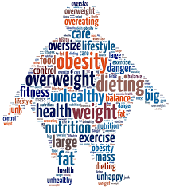
Term Project Presentation
What are the factors of diabetes and obesity
&
How to improve the current situation
Presenter:
Bin He
Damilola Oluyemo
Yujie Pu
ISE 540:507 Data Analytics Engineering System

Slide 2
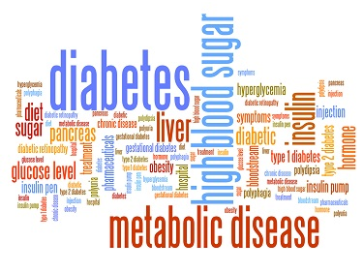
Background
1
Nowadays, people live the sedentary and fast lifestyle.
Infrastructure and amenities available also affect healthy choices.
More people start to have different kinds of illness, such as diabetes, obesity and their complications.
Many people spend lots of money on dealing with those illness.
Unfortunately, some people die from the illness.

Slide 3
Questions
2
Based on the objects and attributes the following questions are put forward:
What are the features/attributes that most affects number of diabetic patients?
What characteristics/traits helps make the states into a cluster? What is the population forecast for 2021?
What is the relationship between highly populated states. health and healthy living options and lifestyle?
What can the government do to help states that have good healthy lifestyle options and bad healthy living options?
ANSWERS/CONCLUSIONS
The following attributes have the most impact on the number of diabetic patients: FM, FFR, SNAPAS, SNAPP, CAC
States like CA, FL, NY and TX have similar attributes, such as high population with at least 20M people, more restaurant/stores, various assistance program & participants and in turn have low diabetes rate and obesity rate.
These states have the richest people and hence more attention is being paid to having a more healthy lifestyle/living than other states.
Government should invest more and drive more policies towards helping the states portrayed as not rich like TN, IN, VA, etc Policy like helping local farmers to improve production, more assistance programs in these regions would also be favorable These states also have low populations but with high diabetes and obesity rates.

Slide 4

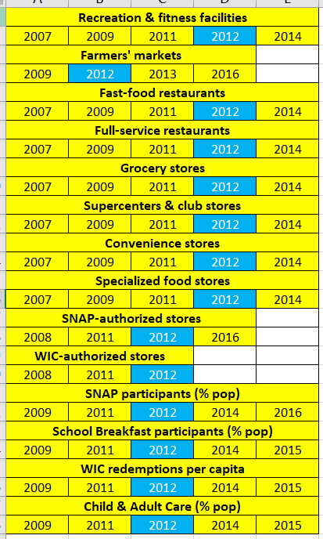
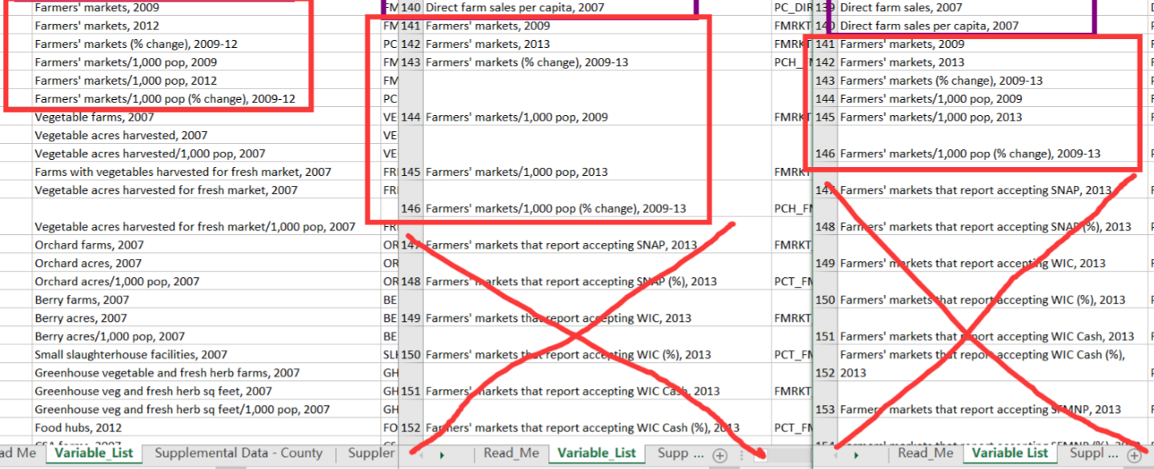
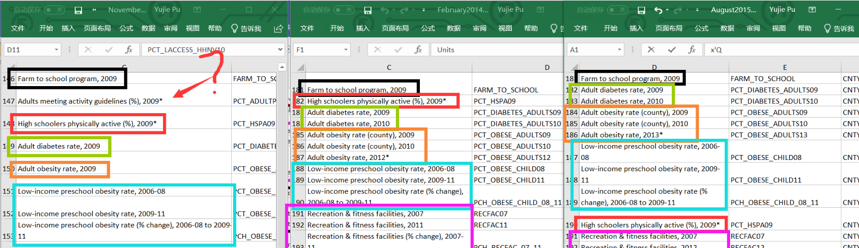
Dataset Introduction
Data Cleaning
3
Dataset was gotten from USDA website:
6 files in total;
Data compiled from 2011 to 2017;
Each file contains 13 spreadsheets and at least 150 variables.
The attribute are grouped into assistance programs by the government, Health Indicator attributes, number of stores, local indicators
Faced with this huge dataset……
Data was cleaned by:
Merging data of years that were similar
Eliminating missing data
Removing redundant variables
All the attributes in the year of 2012 are chosen to create the new dataset because the data in 2012 is the most overlapped one or were readily available.

Slide 5
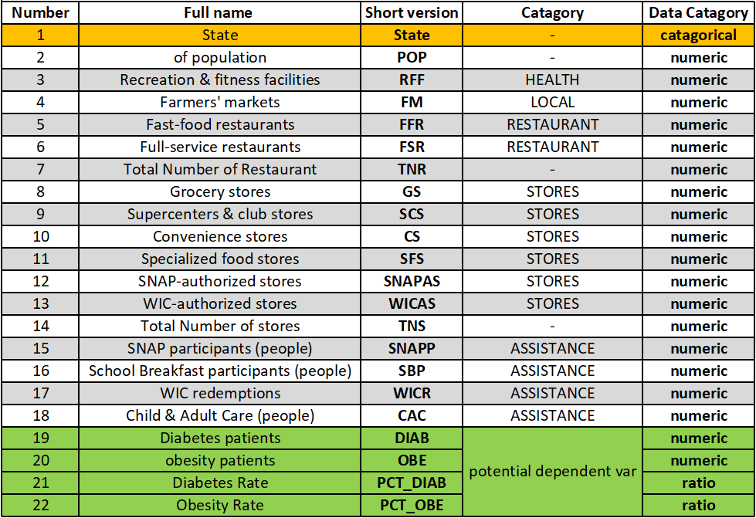
Updated Dataset
4
The new dataset contains:
22 attributes:
51 observations:
(all 51 states in the US)
Faced with 4 potential dependent
variables,
We need to find the relationship
between DIAB and OBE
In people’s mind:
A person who has obesity has a high probability of having diabetes as the same time.

Slide 6
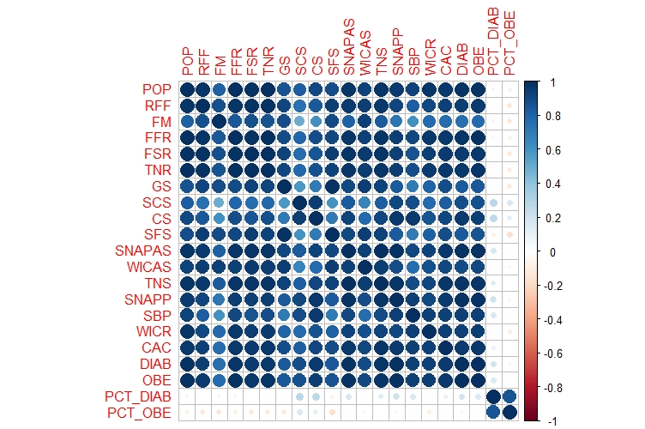
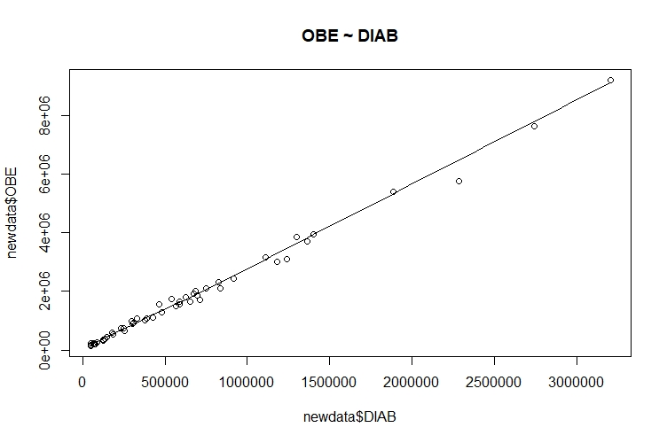
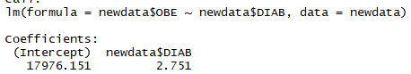
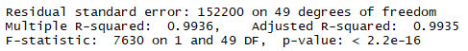
Correlation Coeff. Matrix
Linear Regression
5
This matrix will be used for:
Linear regression of DIAB and OBE;
➔ PCA among all attributes before DIAB;
DIAB and OBE are highly linearly correlated based on either scatterplot, function or R^2 value. So, DIAB is chosen for further analyze.

Slide 7
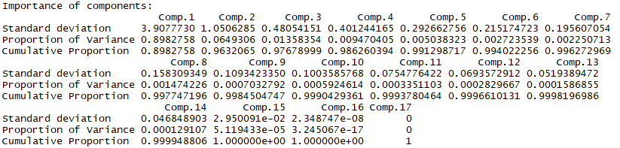
PCA
6
➔ Since PCA can reduce the dimension, we expect that PCA can help to reduce features;
Choose the first two components as they occupy 96.3%, which is >95%;
The screen plot and biplot of the current PCA model can be created.

Slide 8
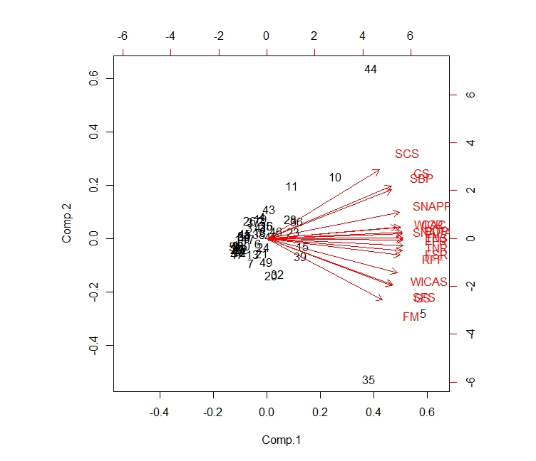
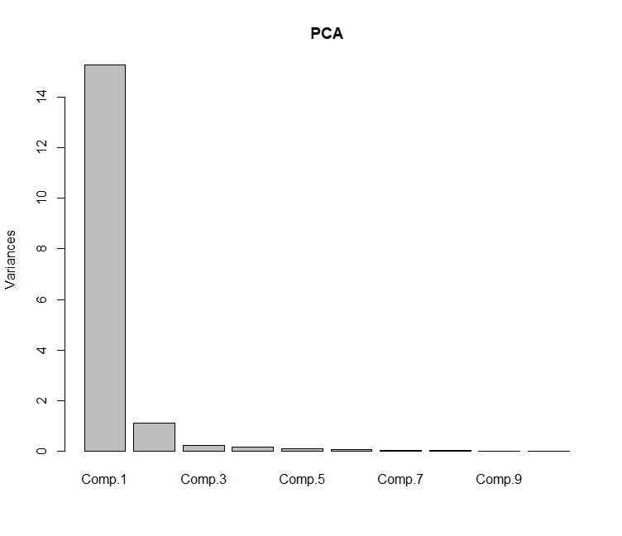
PCA
7
The left graph shows how the variance of each component has.
The right graph shows how each attribute contributes comp. 1 and 2;
PCA reduces the dimension and does a transformation, but it is difficult to interpret because it we can’t account for how each feature/attribute will affect our dependent variable DIAB.
Therefore, we make feature selection via STEPWISE regression;

Slide 9
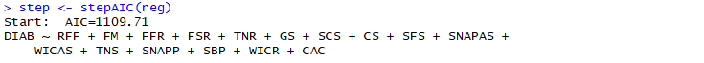
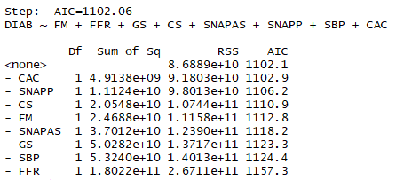
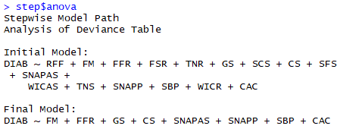
Feature selecting via STEPWISE regression
8
StepAIC and ANOVA methods was used to select features;
Based on above two methods, the final model is:
DIAB ~ FM + FFR + GS + CS + SNAPAS + SNAPP + SBP + CAC
➔ These 8 attributes is selected for the future analysis because it best describes DIAB.

Slide 10
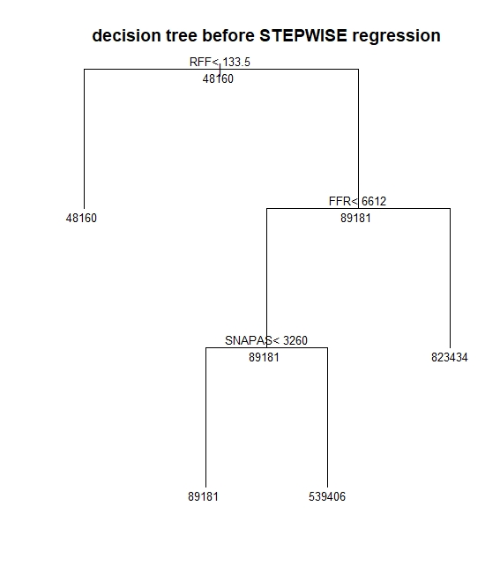
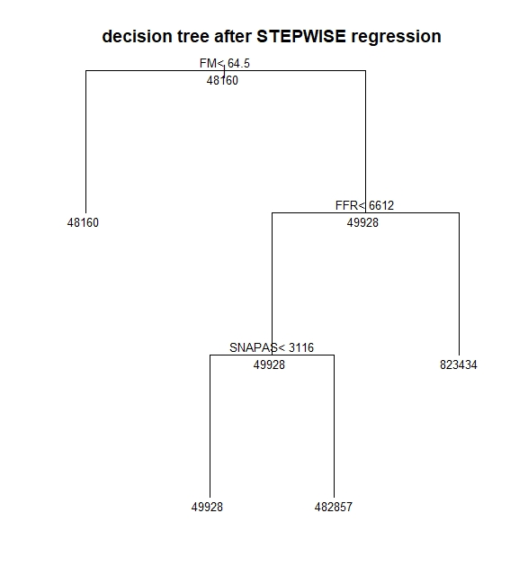
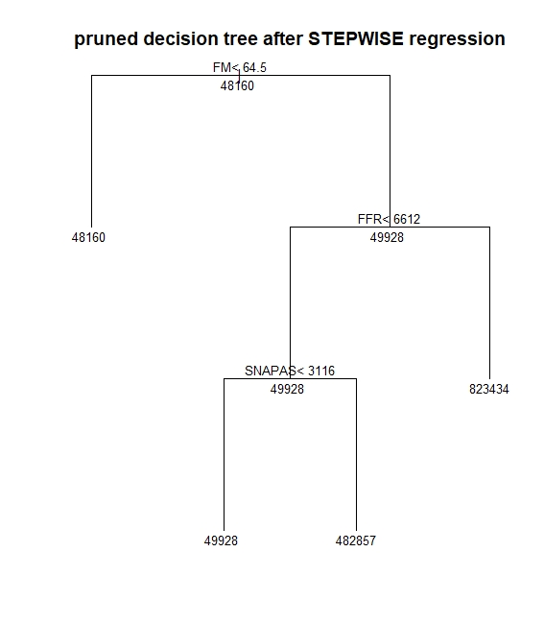
Feature validation by decision tree
9
Reason for doing three decision trees is to see how the attributes change;
Tree 2 and 3 show that FM, FFR, and SNAPAS appear consistently in both two decision trees;
Tree1
Tree2
Tree3

Slide 11
Observation division and Validation
10
Split 51 states into 2 groups based on the on the obesity rate and diabetes rate;
Given the mean value of two groups are 10 and 30, we set these two values are the boundaries. Then we have two new groups:
Then use STEPWISE regression to two groups again, we get the Reg1 and Reg2 models:
➔ FFR, SNAPP and CAC are most common among three models.
Sdata$PCT_DIAB > 10 & Sdata$PCT_OBE > 30 = 1;
!(Sdata$PCT_DIAB > 10 & Sdata$PCT_OBE > 30) = 0;
 | PCT_DIAB > 10 & PCT_OBE > 30 | Otherwise
number | 20 | 31
Reg:
DIAB ~ FM + FFR + GS + CS + SNAPAS + SNAPP + SBP + CAC
Reg1:
DIAB ~ FFR + SFS + SNAPAS + WICAS + SNAPP + SBP + WICR + CAC
Reg2:
DIAB ~ RFF + FFR + FSR + SCS + SFS + WICAS + SNAPP + WICR + CAC

Slide 12
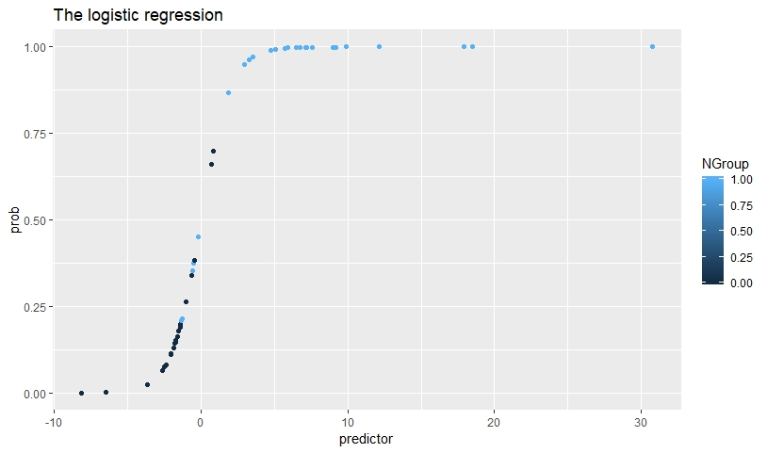
Classification
11
➔ We use 70% of the datasets as the training set and 30% as the validation set.
35 observations in training set and 16 observations in test set
Naïve Bayes, KNN, and Logistic regression are used to check the accuracy.
The method with highest accuracy will be used to future forecast.
In addition, one more method named SVM will be used later.
Method | Naïve Bayes | KNN | Logistic model
Accuracy | 0.7843 | 0.1219 | 0.9020

Slide 13
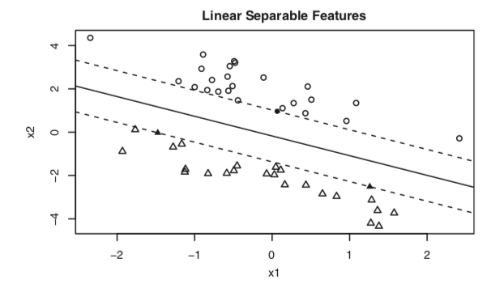
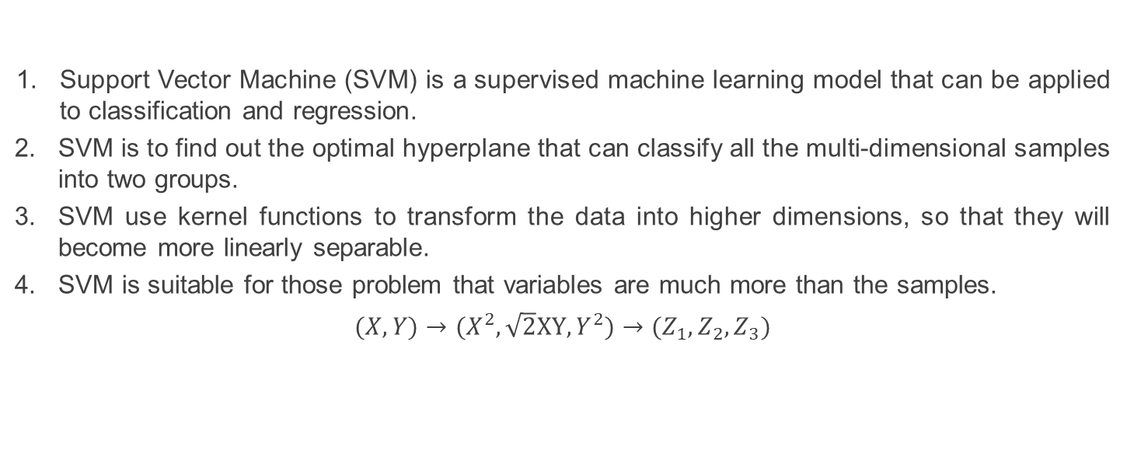
Classification: Support Vector Machine (SVM)
12
Support Vector Machine (SVM) is a supervised machine learning model that can be applied to classification and regression.
SVM is to find out the optimal hyperplane that can classify all the multi-dimensional samples into two groups.
SVM use kernel functions to transform the data into higher dimensions, so that they will become more linearly separable.
SVM is suitable for those problem that variables are much more than the samples.
$(X,Y)→(X^{2}, \sqrt{2}XY, Y^{2})→(Z_{1},Z_{2}, Z_{3})$
Source: R in action, Robert I. Kabacoff

Slide 14
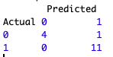
Support Vector Machine (SVM)
13
According to the same observation division rule in previous slide.
There are two dependent variables: Diabetes rates and Obesity rate.
Threshold--Mean of Diabetes Rate is 10%, Mean of Obesity Rate is 30%
Diabetes Rate > 10% AND Obesity Rate > 30% ⬅ 1
Diabetes Rate <= 10% OR Obesity Rate< 30% ⬅ 0 (rest)
After training, we find the result is as high as 93.75% = (4+11)/16

Slide 15
Population Forecast
14
We collected the raw data from 2007 to 2016 for all the states in the US including AK and HI.
➔ Forecast the population from 2017 to 2021 by using R forecast function with 99.5% confidence interval.

Slide 16
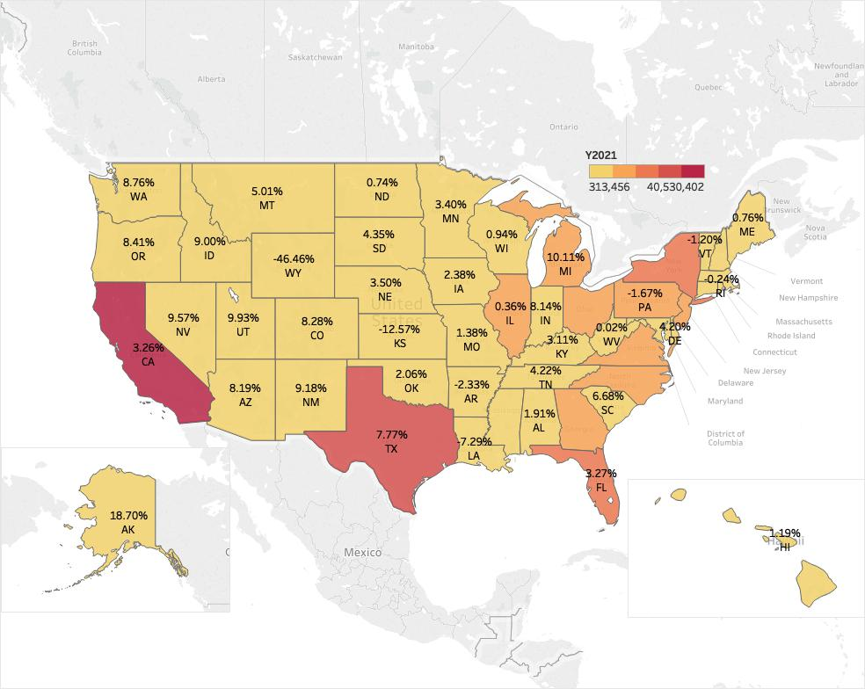
Time Series: Population Forecast
15
We forecast the US population in order to get the potential population of unhealthy people in the next 5 years.
Time Series: ARIMA
To clearly show the population forecast, we use Tableau to plot the US map.
designed to fit stationary time series whose properties of the series don’t change over time

Slide 17
Clustering
16
The reason that we use clustering is to find out which states behave similarly with 2 to 18 attributes regarding local people’s health.
The government could plan the budget which can optimally be invested to the right states to improve the national health status of its citizens.
R shows the optimal number of clusters for K means is 4 and for Hierarchical clustering is 3.
Within-groups sums of squares vs. the number of possible clusters. The sharp decreases from one to 4 clusters suggests a 4-cluster solution.

Slide 18
K Means Clustering VS Hierarchical Clustering
17
Both methods classify 51 states into 4 groups with slightly different members.
Because it’s based on means, the k-means clustering approach can be sensitive to outliers. So we recommend to use Hierarchical Clustering which has 3 groups.

Slide 19
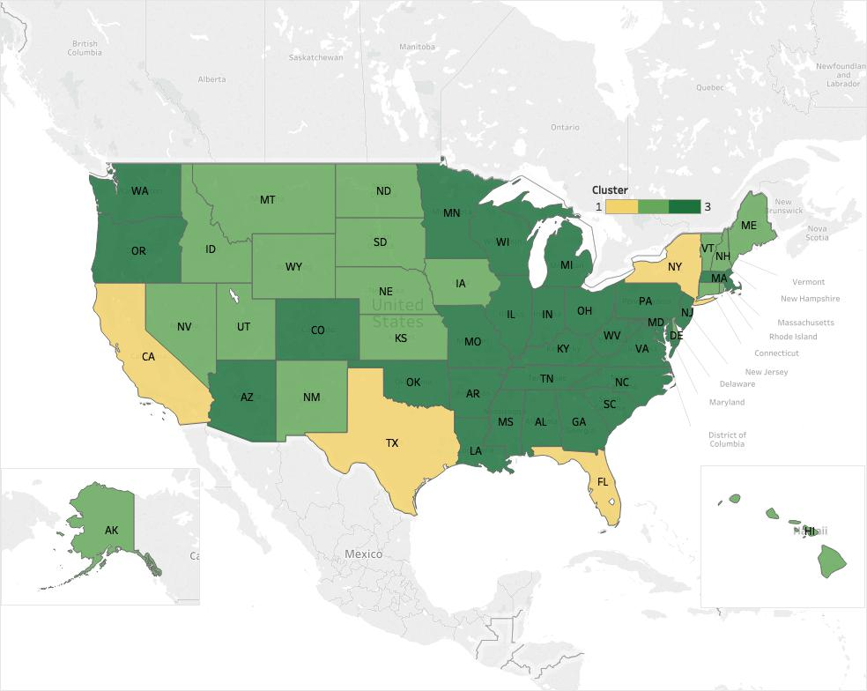
Conclusion to the clustering methods
18
➔ CA, FL, NY & TX have similar traits, such as large population with at least 20M people, more restaurant / stores and various assistance program participants but have low diabetes rate and obesity rate.
➔ On the contrary, States like WA, OH, AZ…are the poor regions that have relatively smaller population but with higher diabetes and obesity rates. In these areas, people reluctantly use their money on the health improvement programs.

Slide 20
Conclusions
1
19
1. The following attributes have the most impact on the number of DIAB:
FM, FFR, SNAPAS, SNAPP, CAC
2. States like CA, FL, NY and TX which have the similar attributes, such as high population with at least 20M people, more restaurant/stores and various assistance program participants but have low diabetes rate and obesity rate.
3. These states have the richest people and hence more attention is being paid to having a more healthy lifestyle/ living than other states.
4. Government should invest more and drive more policies towards helping the states portrayed as not rich like TN, IN, VA, etc. Policy like helping local farmers to improve production, more assistance programs in these regions would also be favorable These states also have low populations but with high diabetes and obesity rates. For example the red sections in Hierarchical Clustering model which are on the right hand side—TN, IN, VA, etc…

Slide 21
Recommendation
20
➔ Government should invest more and drive more policies towards helping the states portrayed as not rich like TN, IN, VA, etc. Policy like helping local farmers to improve production, more assistance programs in these regions would also be favorable.
FUTURE WORK TO BE DONE:
The data we have is from 2012, the future work we’ll do is try to get a much recent data, validate our findings and improve on our analysis.

Slide 22
Thank you for listening!
Presenter:
Bin He
Damilola Oluyemo
Yujie Pu

Slide 23


